Slide 1
Classification of bridges based on Linked Data and Semantic Web technology
Jan Erik Hoel, Trimble
Lars Wikstrøm, Triona

Slide 2
Agenda
Presentation of the E39 Bjørnafjorden project
Bjørnafjorden Open Live Centre (BOLC)
The structure of the classification system V440
Why use Linked Data/Semantic Web technology (LD/SW)
Extremely brief introduction to LD/SW
How V440 is modelled with LD/SW technology
The way forward

Slide 3
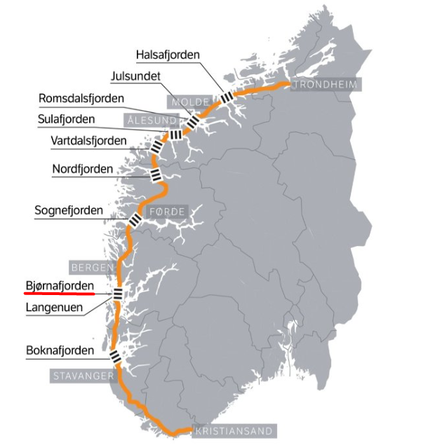
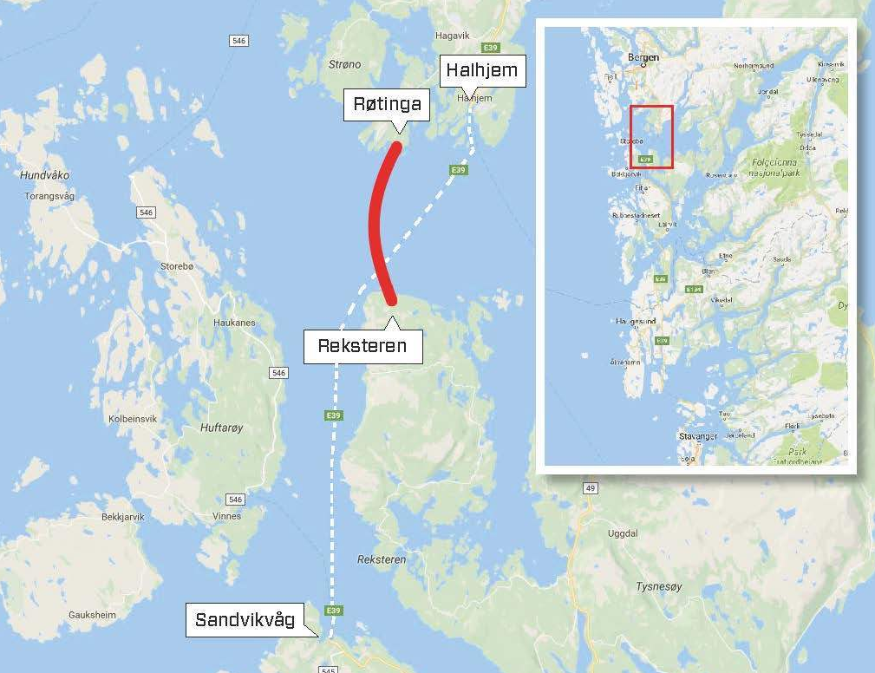
E39 Bjørnafjorden project

Slide 4
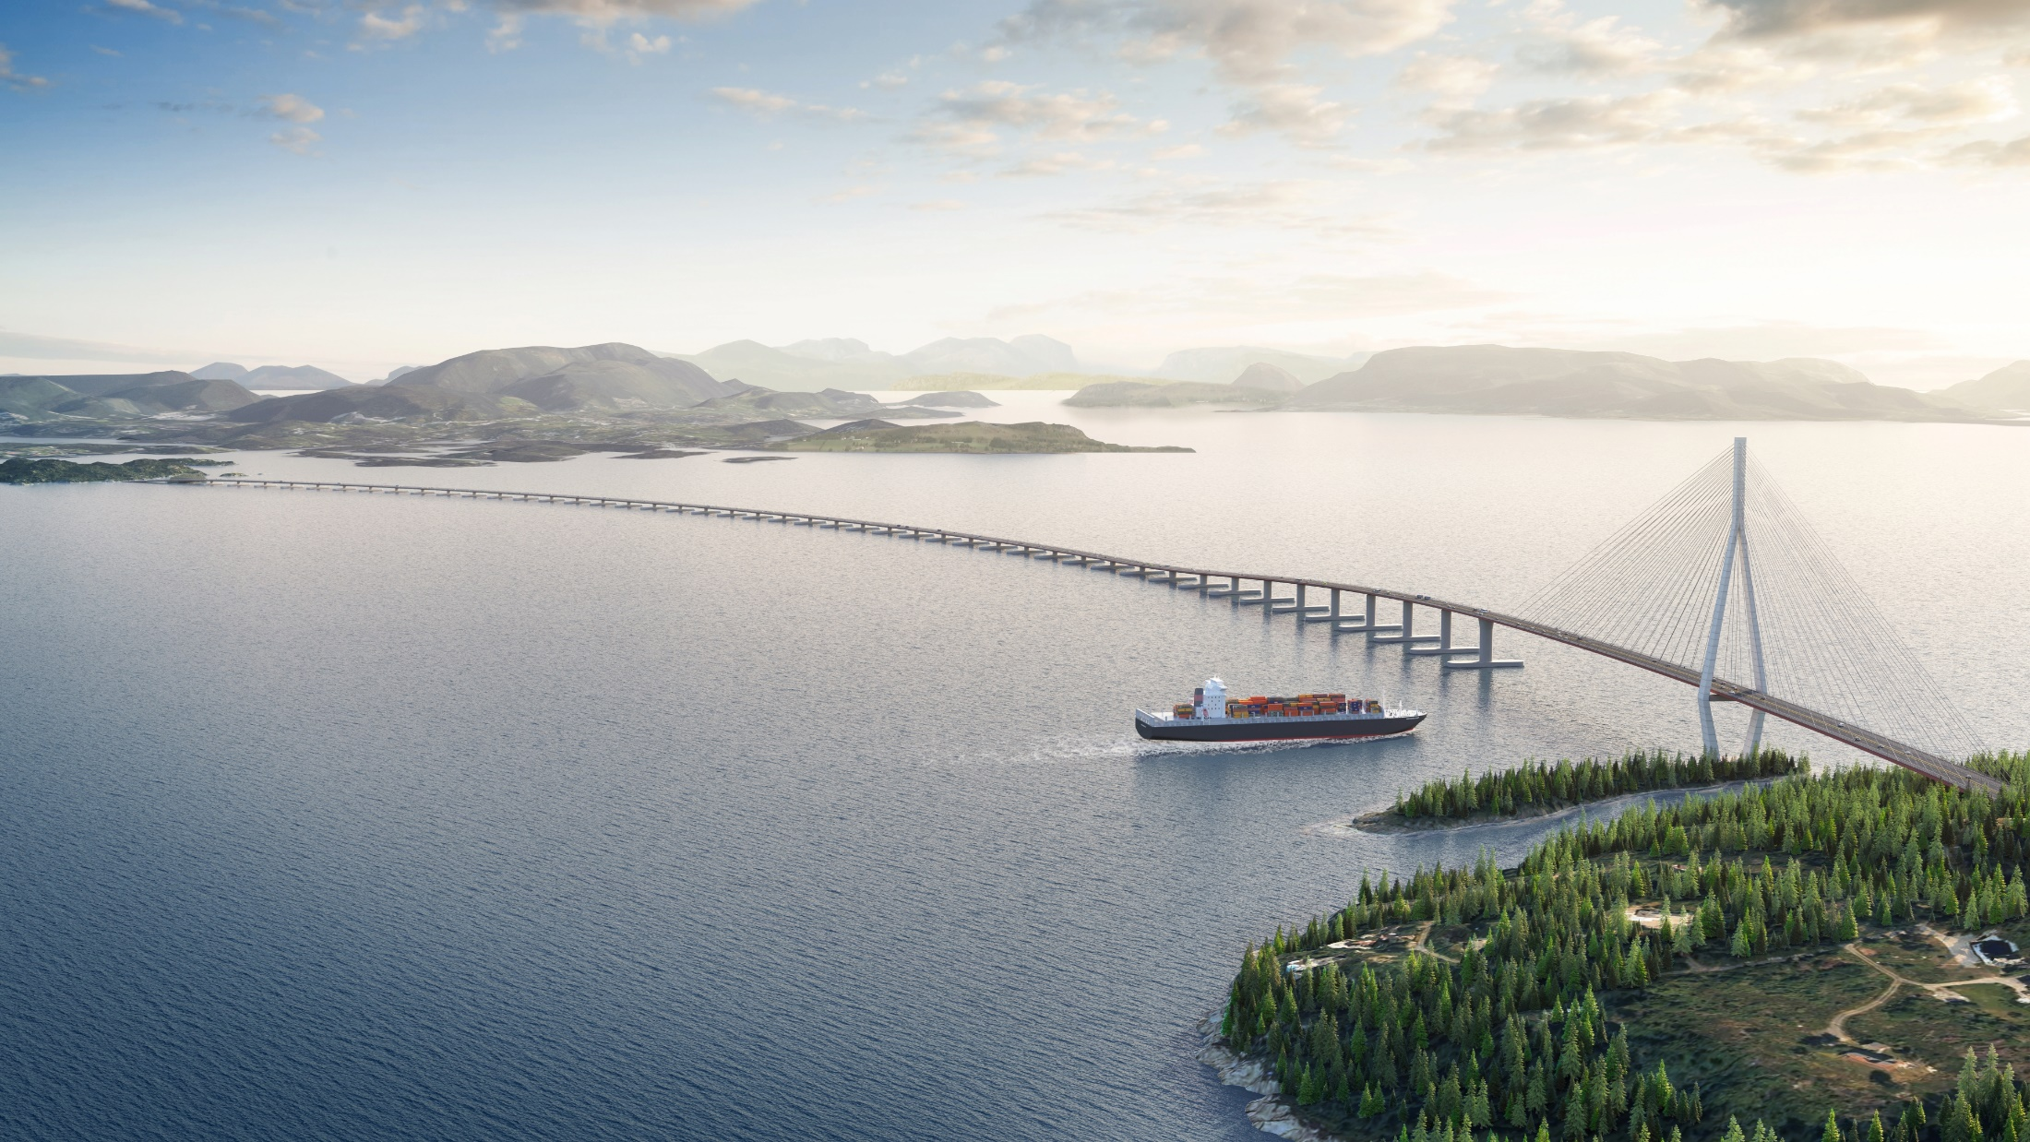
E39 Bjørnafjorden project
Selected concept

Slide 5
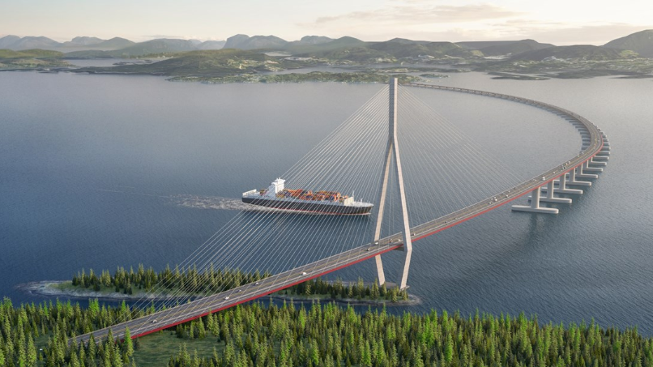
E39 Bjørnafjorden project
Key values
Chosen concept: Floating bridge with anchor cables, fixed at one side.
Cable-stayed bridge at one side
Total length: 5,5 km
Fjord depth: 550 m
About 110 000 ton steel
About 35 pontoons
Main span of the cable-stayed bridge: 450 m
Bridge tower height: 215
Free sailing clearance: 50 m
Estimated cost: 17 billion NOK
Municipality plan approved 2019
Assumed start constuction 2024, finished 2028
Cost risks
Marked (steel)
Logistics

Slide 6
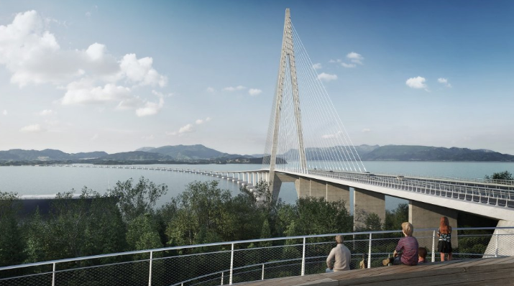
E39 Bjørnafjorden project
Data management ambitions
BIM-model: From CAD-layer based data to level 3 BIM-model
Document management system: - Integrated with the BIM-model - Easy to search and find all relevant documentation
Seamless data transfer from design and build models (PIM) to asset management models (AIM)
Dashboard solution: Bjørnafjorden Open Live Centre (BOLC)

Slide 7
E39 Bjørnafjorden – Open Live Centre (BOLC)
Plan
Design
Maintain
Build
Operate
BIM-server
Document Management
Databases
Open Live Centre
Project management tool for the E39 Bjørnafjorden project

Slide 8
E39 Bjørnafjorden – Open Live Centre (BOLC)
Functionality examples for Open Live Centre (BOLC):
Extract and present data from the BIM-server
Harvest and publish data from different sources, like:
Quantities
Collisions and constructability
Cost / Compensations
Status / Progress
Logistics
RFID-sensors/ QR-code readings
HR-data
Environmental data
Surveillance camera
Visualisation / Animation
Etc.

Slide 9

Nordlenningen
*****************
Log In
Notes:
Kongstanken – et LIVE center:
Høster data fra BIM-serveren – en dynamisk kobling
Også data fra andre kilder som overvåkningskamera, og data fra sensorer som strekklapper
- Logistikk - Kostnader - Kompensasjon - Visualiseringer - Kollisjoner - Mengder og antall - Analyser
- Status/fremdrift

Slide 10

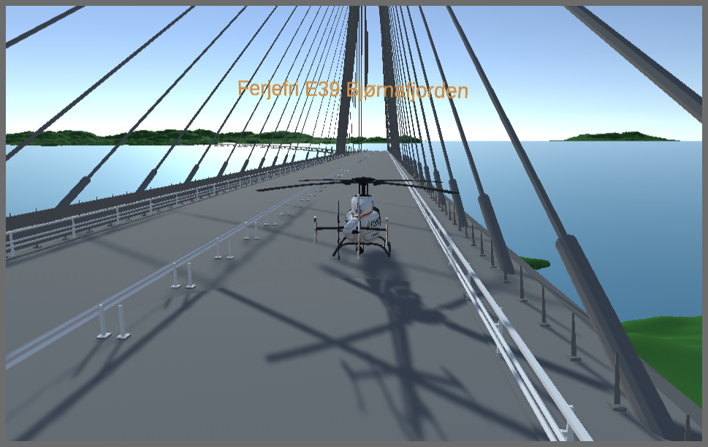
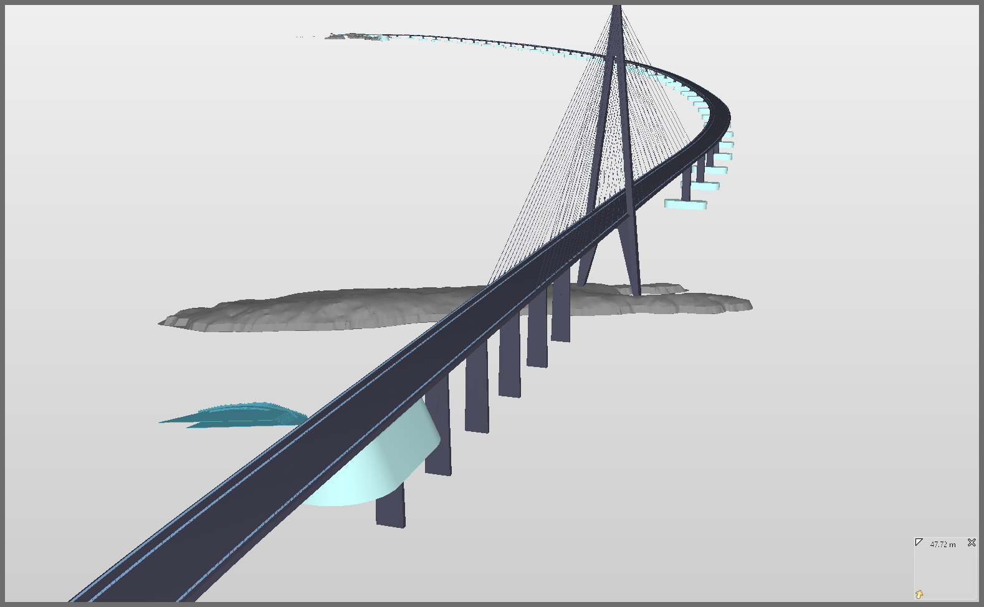
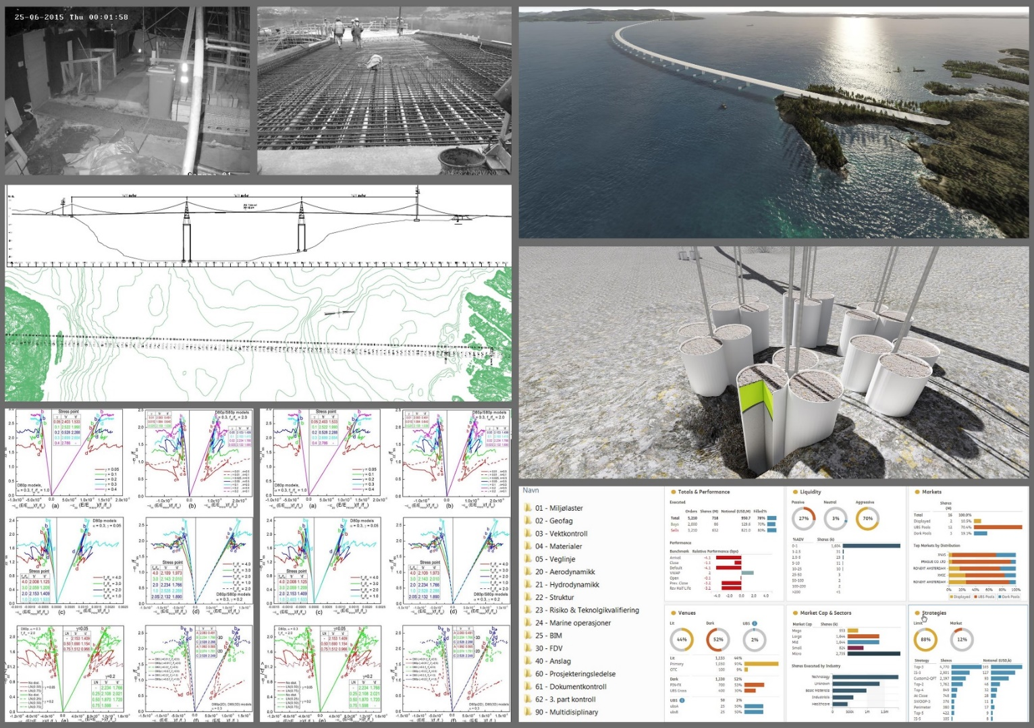

Notes:
Kongstanken – et LIVE center:
Høster data fra BIM-serveren – en dynamisk kobling
Også data fra andre kilder som overvåkningskamera, og data fra sensorer som strekklapper
- Logistikk - Kostnader - Kompensasjon - Visualiseringer - Kollisjoner - Mengder og antall - Analyser
- Status/fremdrift

Slide 11
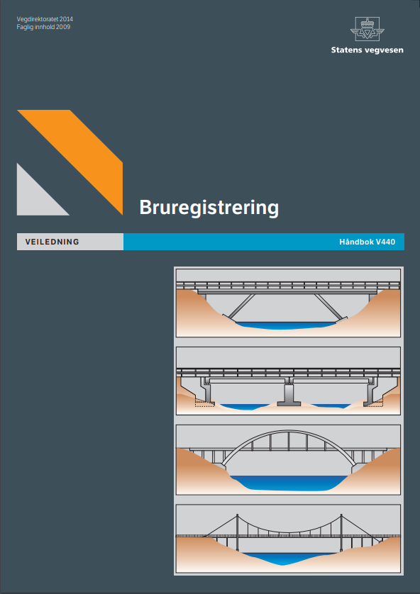
V440 - The Norwegian Road Authority’s manual for bridge registration
The main purpose of the manual is to provide guiding for the personnel who do the registration and condition-monitoring of the bridges on the main road network in Norway.
The manual contains registration process descriptions and rules for bridge document management.
In addition the manual provides a comprehensive list of definitions of bridge types and bridge parts, that is bride classification.

Slide 12
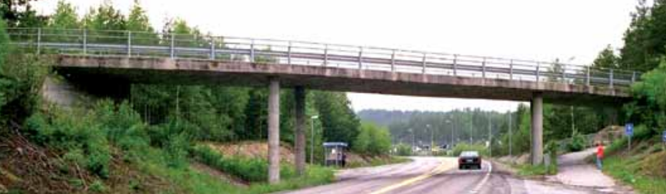
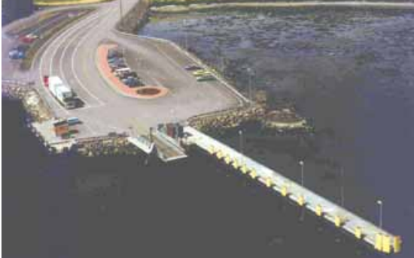
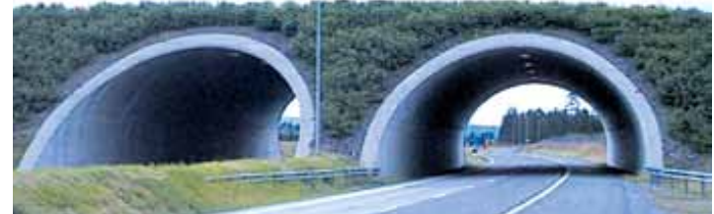
V440 - The Norwegian Road Authority’s manual for bridge registration
Examples of bridge classification:
Bridge Categories:
Code Description
1 Road bridge
2 Bridge embedded in the road superstructure
3 Pedestrian bridge
4 Ferry landing
6 Tunnel
7 Supportive structures
8 Railroad bridge
9 Other structures

Slide 13
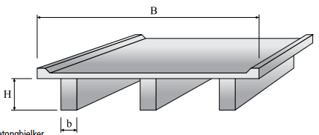
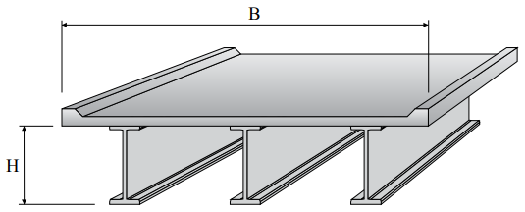
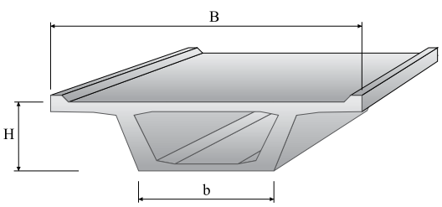
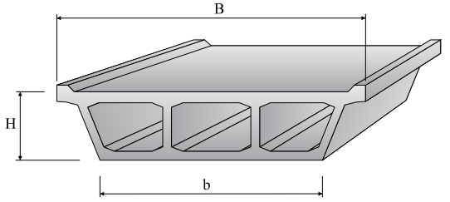
Examples of bridge classification:
Bridge Types:
Beam bridges:
Concrete beam bridge
Steel beam bridge
Box bridges:
Box bridge
Multiple box bridge

Slide 14
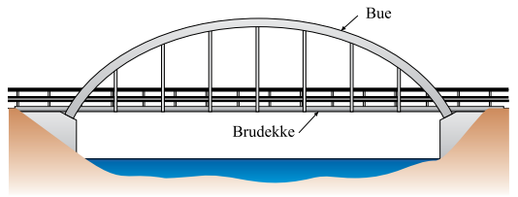
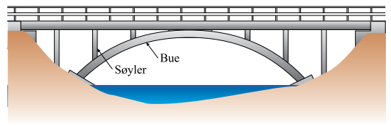
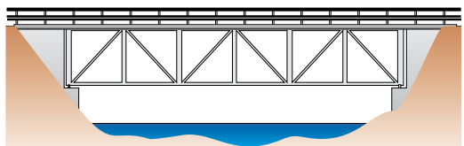
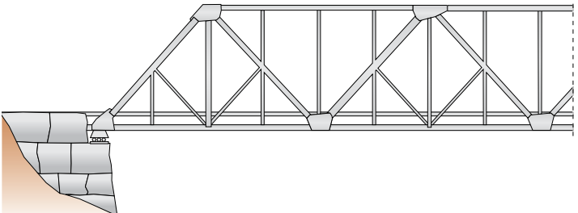
Examples of bridge classification:
Bridge Types:
Arc bridges:
Arc bridge with upper carriageway
Arc bridge with lower carriageway
Truss bridges:
Truss bridge with upper carriageway
Truss bridge with lower carriageway

Slide 15
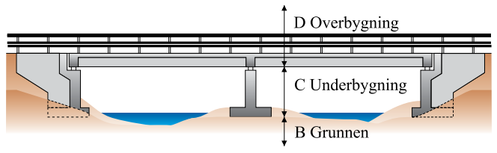
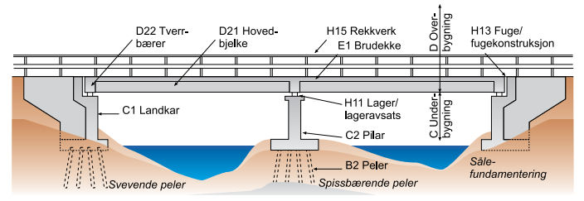
Examples of bridge classification:
Main Groups of Bridge Element Codes:
Code Description
B Ground
C Substructure
D Superstructure
E Bridge Deck
F Structure embedded in filling
H Equipment

Slide 16
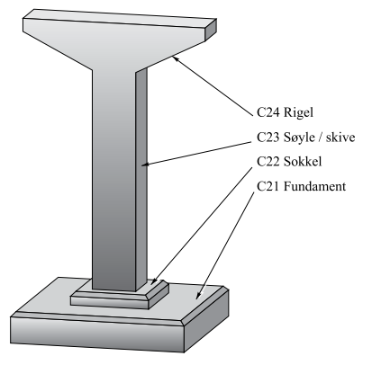
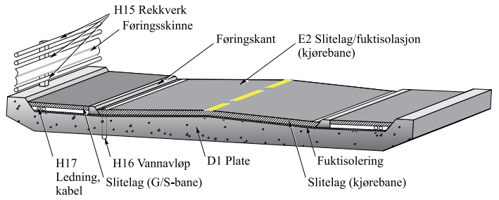
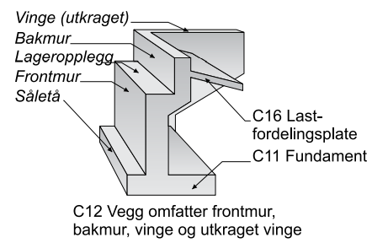
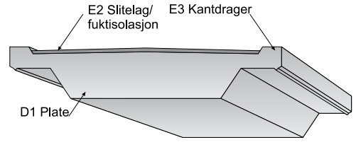
Examples of bridge classification:
Detailed Bridge Element Codes:

Slide 17
Why use Linked Data and Semantic Web (LD/SW) for BOLC
Why use LD/SW technology:
BOLC is an integration project. An integration project needs a common data model to be able to interpret and accumulate data
LD/SW is an extremely flexible technology for data modelling of different domains and combining these domains
The LD/SW technology is mature based on a well-developed standardisation work from international bodies like World Wide Web Consortium (W3C) and ISO
By using LD/SW technology as the back-bone of the integration architecture, we’ll facilitate an extremely flexible integration solution.
Why use V440 – Norwegian Bridge classification system :
For integration projects, it is crucial to have a common understanding of the domains
V440 provides a fully developed data model/ classification system for the main domain for this integration project
V440 is relevant for Norwegian conditions
V440 will be the “centre ontology” for the integration work, like the Core EUROTL on the next slide

Slide 18
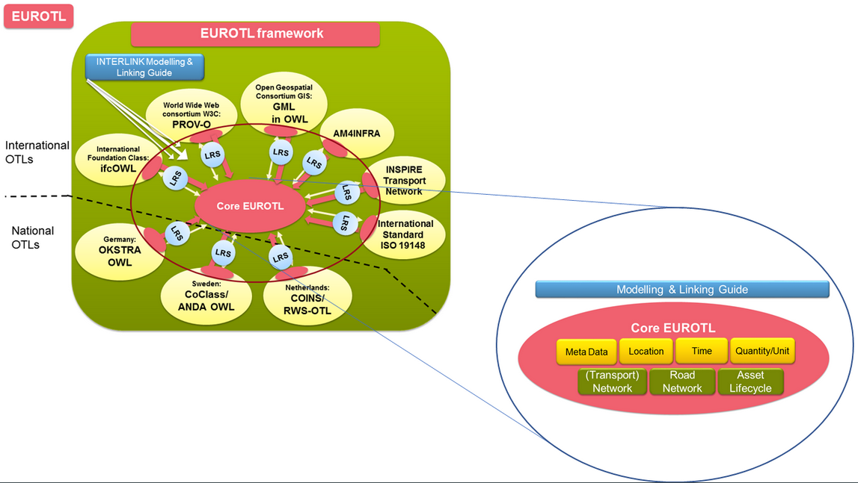
Interlink - EUROTL

Slide 19
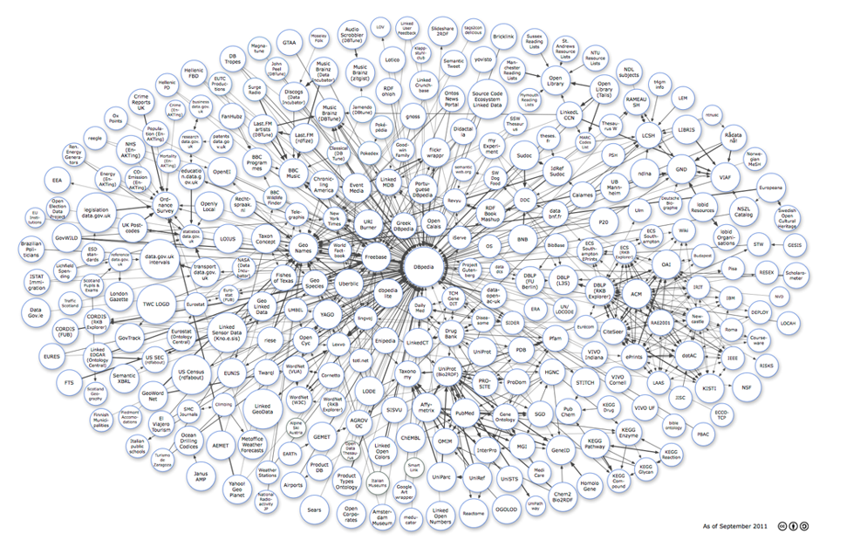


Linked Data & The Semantic Web – Crash course (5 mins)
http://www.w3.org/standards/semanticweb/

Slide 20

Linked data – starting with the web (linked documents) Physical machines abstracted away
URL
URL
URL
URL

Slide 21
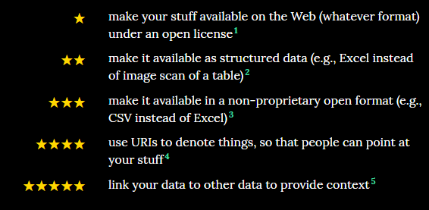
Linked data - Semantic Web (Web of data)

Slide 22
Basic concepts
RDF Resource Description Framework
RDFS – One level up
Resource Description Framework Schema
SPARQL
SPARQL Protocol and RDF Query Language
GeoSparQL
Ontologies OWL == Web Ontology Language

Slide 23
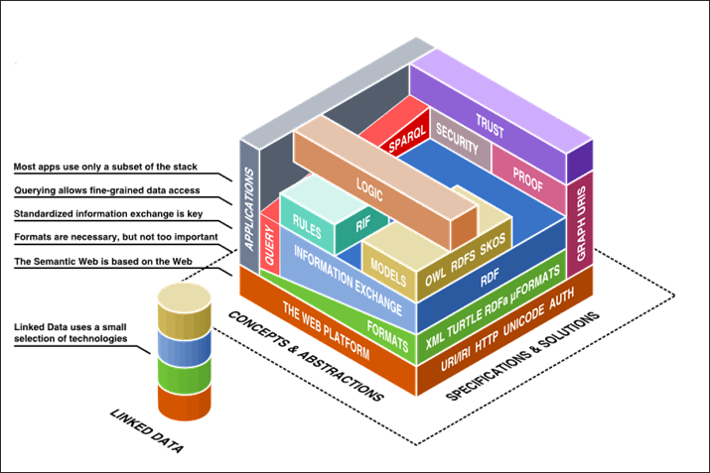
Technology Stack – Web technology

Slide 24

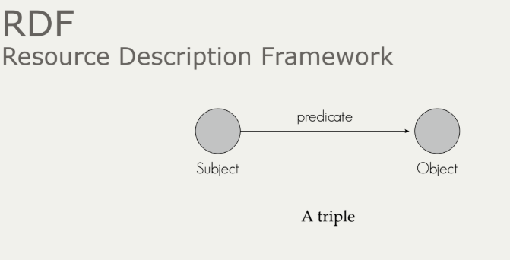
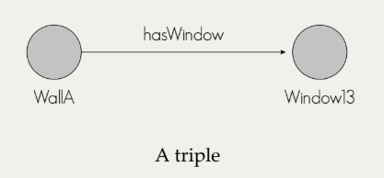
Basic Concepts
RDF – Resource Description Framework

Slide 25
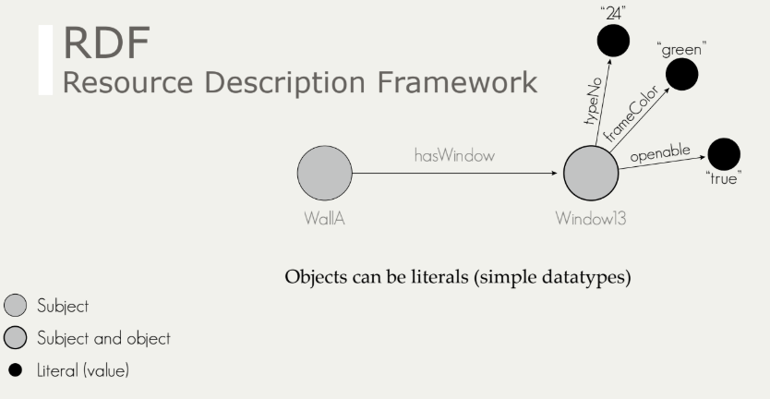
Basic Concepts

Slide 26
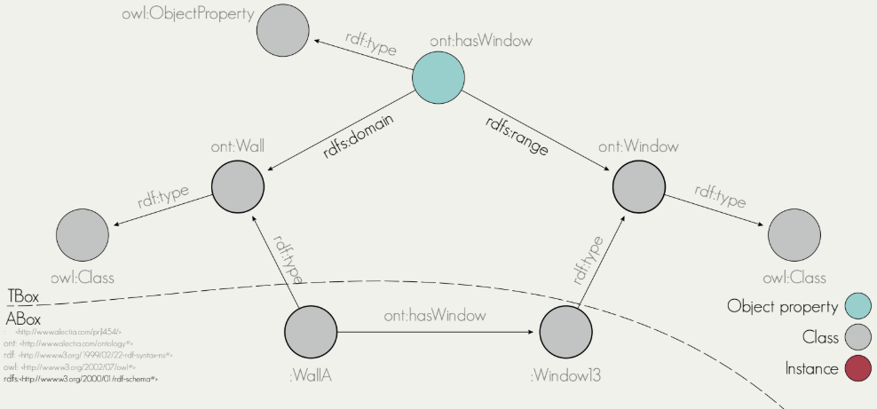
Basic Concepts
RDFS – RDF Schema

Slide 27

Basic Concepts
SPARQL – Querying the semantic web
SELECT ?wall ? Window
WHERE {
?wall rdf:type ont:Wall .
?wall ont:hasWindow ?window .
}

Slide 28
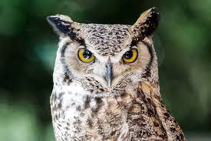
Basic Concepts
OWL – Ontologies (RDFS++)
Web Ontology Language
OWL includes RDFS plus much more:
E.g. Class “Mother” is the intersection of classes “Parent” and “Woman”
E.g. My class “Wall” is equivalent to the class “IfcWall”
E.g. System-A:BridgeA is the same as System-X:BridgeX
OWL gives you a much larger vocabulary to play with =>It makes it easy to say anything you might want to say about your data =>OWL allows you to easily express the relationships between different ontologies using a standard annotation framework.
Semantic reasoning
Inferring new triples (knowledge) from existing triples
E.g. This individual belongs to “Parent” and “Woman” => Must be a “Mother”

Slide 29
Use cases
Make structure explicit and readable/understandable by machines/applications
RDF, RDFS, OWL
Referenceable from other standards/formats such as IFC & *GML
Through the use of de-referenceable URI:s
Easily ”mappable” to other structures
Through ”Linking Rule Sets”, i.e. ontologies of their own right, specifying schema level relationships
Available through standard Web API:s
http GET, SPARQL endpoint
For free:
Exchange format for both schema and data (XML, Json, Turtle, …)

Slide 30
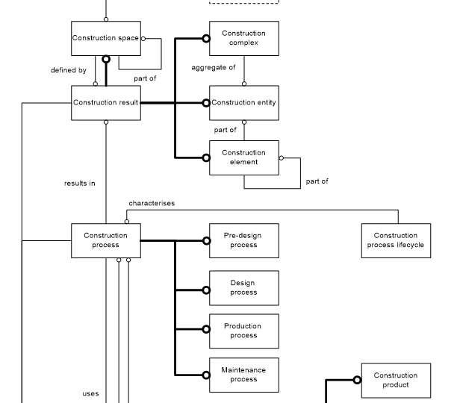
Inspiration from ISO 12006-2 Building construction — Organization of information about construction works — Part 2: Framework for classification
Construction complex
aggregate of construction entities serving at least one user activity or function
Construction entity
an independent unit of the built environment with a characteristic spatial structure, serving at least one user activity or function
Construction Entity part
constituent of a construction entity
Construction element
constituent of a construction entity with a characteristic technical function, form or position
Construction process
process which uses construction resources to achieve construction results

Slide 31
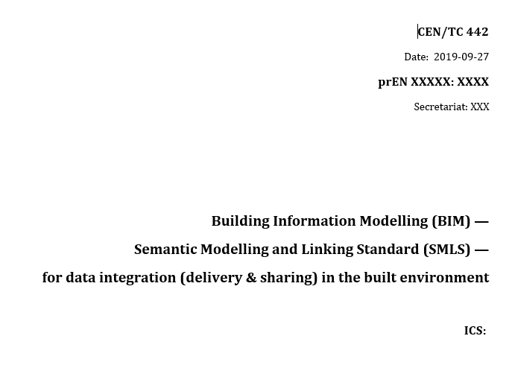
Use of CEN/TC442 Semantic Modelling and Linking Standard - Including the basicsemantics ontology

Slide 32
Basic concepts used in RDF, RDFS and OWL
URI:s identify each concept
Define the concepts using owl:Class
Define relationships between classes using
rdfs:subClassOf (for the taxonomy)
basicsemantics:hasPart (for the meronomy with restrictions)
And other owl:ObjectProperty if needed
Define the properties using owl:DatatypeProperty
Connect properties and classes with restrictions (cardinality, type)
rdfs:domain, rdfs:range and/or owl:Restriction
Define Annotation using owl:AnnotationProperty
E.g. capture the ”Codes” used in V440

Slide 33
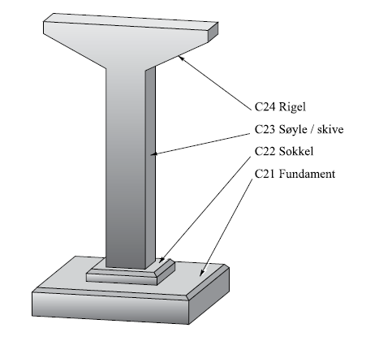
A challenge
The handbook defines a hierarchical structure of classes/codes, but
It is not always strict with regards to the nature of the hierarchy
E.g. taxonomies vs meronomies
rdfs/owl needs to support reasoning and to be ”semantically strict”
A class is a set
rdfs:subClassOf specifies a subset (used for taxonomies)
Example: Pillar
In V440 there is no clear difference beteen
The relationship between BuildingElement vs Pillar (is-a)
And the relationship between Pillar and Foundation (has-a)

Slide 34


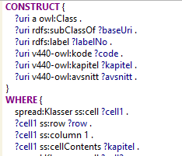


The process
Define principles
Verify principles with domain experts
Verification
Validation
Generate V440 ontology using SPARQL/SPIN
Define Excel structure
Bulk input from domain experts
Convert excel to rdf (generic spreadsheet structure)

Slide 35
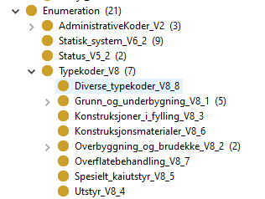
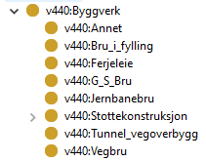
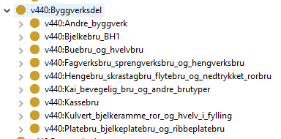
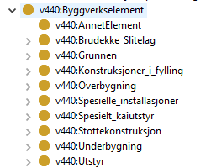
Ontology
Properties
Construction entity
composition
composition
Construction entity part
Construction element

Slide 36
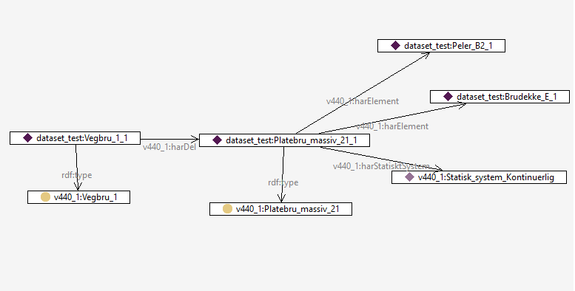
Example dataset
dataset_test:Brudekke_E_1 rdf:type v440_1:Brudekke_E ; . dataset_test:Peler_B2_1 rdf:type v440_1:Peler_B2 ; . dataset_test:Platebru_massiv_21_1 rdf:type v440_1:Platebru_massiv_21 ; v440_1:harElement dataset_test:Brudekke_E_1 ; v440_1:harElement dataset_test:Peler_B2_1 ; v440_1:harStatisktSystem v440_1:Statisk_system_Kontinuerlig ; . dataset_test:Vegbru_1_1 rdf:type v440_1:Vegbru_1 ; v440_1:harDel dataset_test:Platebru_massiv_21_1 ;

Slide 37
The way forward
An ontology (OTL) for V440 will be finished and published before March 2020
Further work on Linked Data Sets (LDS) to other relevant OTLs (IFC e.g.) will probably start in the spring 2020
The public tender for implementation of BOLC will be issued in Q1 2020
Software vendors will be invited to an “interoperate” from mid-April to the end of June 2020
The purpose is to prototype the integration of LD/SW technology and the V440 OTL in relevant software products
Will be arranged as facilitated workshops with independent work sessions in between
Information about this project, the LD/SW technology and the developed ontologies will be given to the industry in breakfast meetings, newsletters, seminars etc. It is important to get the industry engaged.

